Slide 1


Literary Contest Seeker
Dr. A.P.J. Abdul Kalam Technical University,
A-31, UPIDC, Industrial Area, Naini, Prayagraj
Ayush Mishra
Roll: 2000100130055
United College of Engineering and Research, Prayagraj

Slide 2

Abstract
To the writers out there it is a monumental problem to find the right kind of contest to take part into. Literary Contest Seeker can help them seek their right contest amongst the sea of hundreds of such competitions. It asks for user input for their choice of attributes that they are looking in a contest and gives out a result which on clicking opens the website for that competition.
The prototype is in C language and a dummy website is presented along with it to showcase the working of the project.
The static website is created using Hyper Text Markup Language and Cascade Style Sheets is used for designing.

Slide 3

Problem Statement
It has always been evident that finding the right kind of contest for an individual is even harder than writing itself, there are several layers (National , Regional , International contests , poetry or prose , free or paid etc.) to it, which makes it tougher for us 2 research through the countless of such competitions.

Slide 4

Aim
The aim is to reduce the amount of time add efforts consumed throughout the process of searching the right contest.

Slide 5

Objective
To categorise the contest on basis of the following Location
1. Location
2. Attribute
3. Entry fees
To find one’s individual type of contest through toughness level.
To learn about the competitions through precise descriptions.
To categorise on basis of Prize offered.

Slide 6

Specifications
Operating System: Windows 10
Processor: Intel Core i5
(Minimum requirement for running VS code)
MinGw 32 bit – C compiler
Notepad
Browser: Microsoft Edge
RAM: Minimum of 4GB
HDD: 265GB

Slide 7
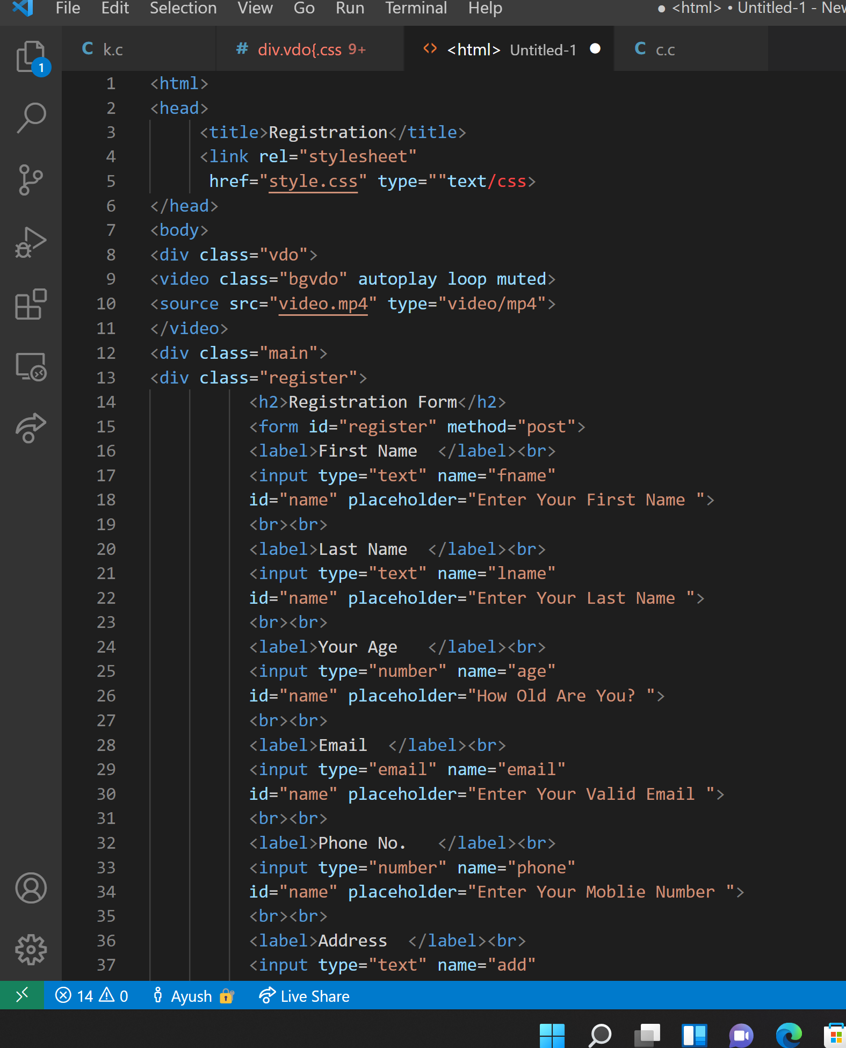
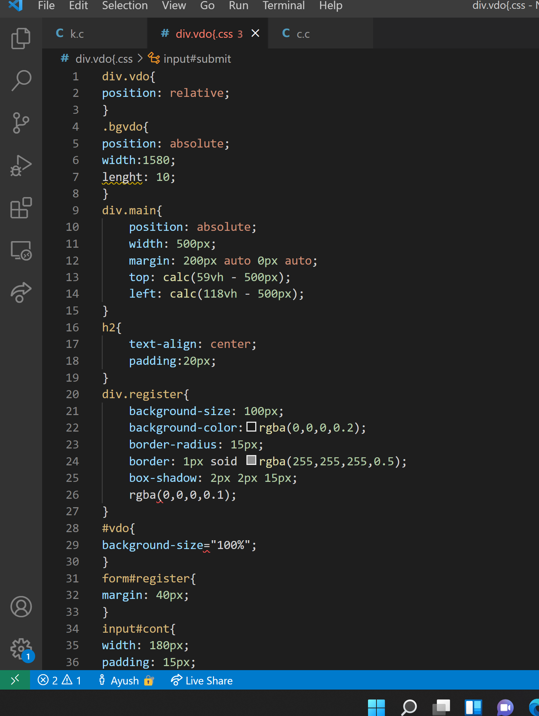
Codes Snippets

